Slide 1

SYNOPSIS Presentation
on
Personal finance Tracker
by
Aanchal Choudhary 202410116100002
Brijesh Sharma 202410116100052
Devesh Alan 202410116100061
Bobby Karnik 202410116100051
Session:2025-2026 (IV Semester)
Under the supervision of
Ms./ Sonam Jain
Department Of Computer Applications
KIET GROUP OF INSTITUTIONS, DELHI-NCR, GHAZIABAD-201206

Slide 2

AI-Powered Personal Finance Tracker
Smart Expense Prediction & Automated Entry

Slide 3
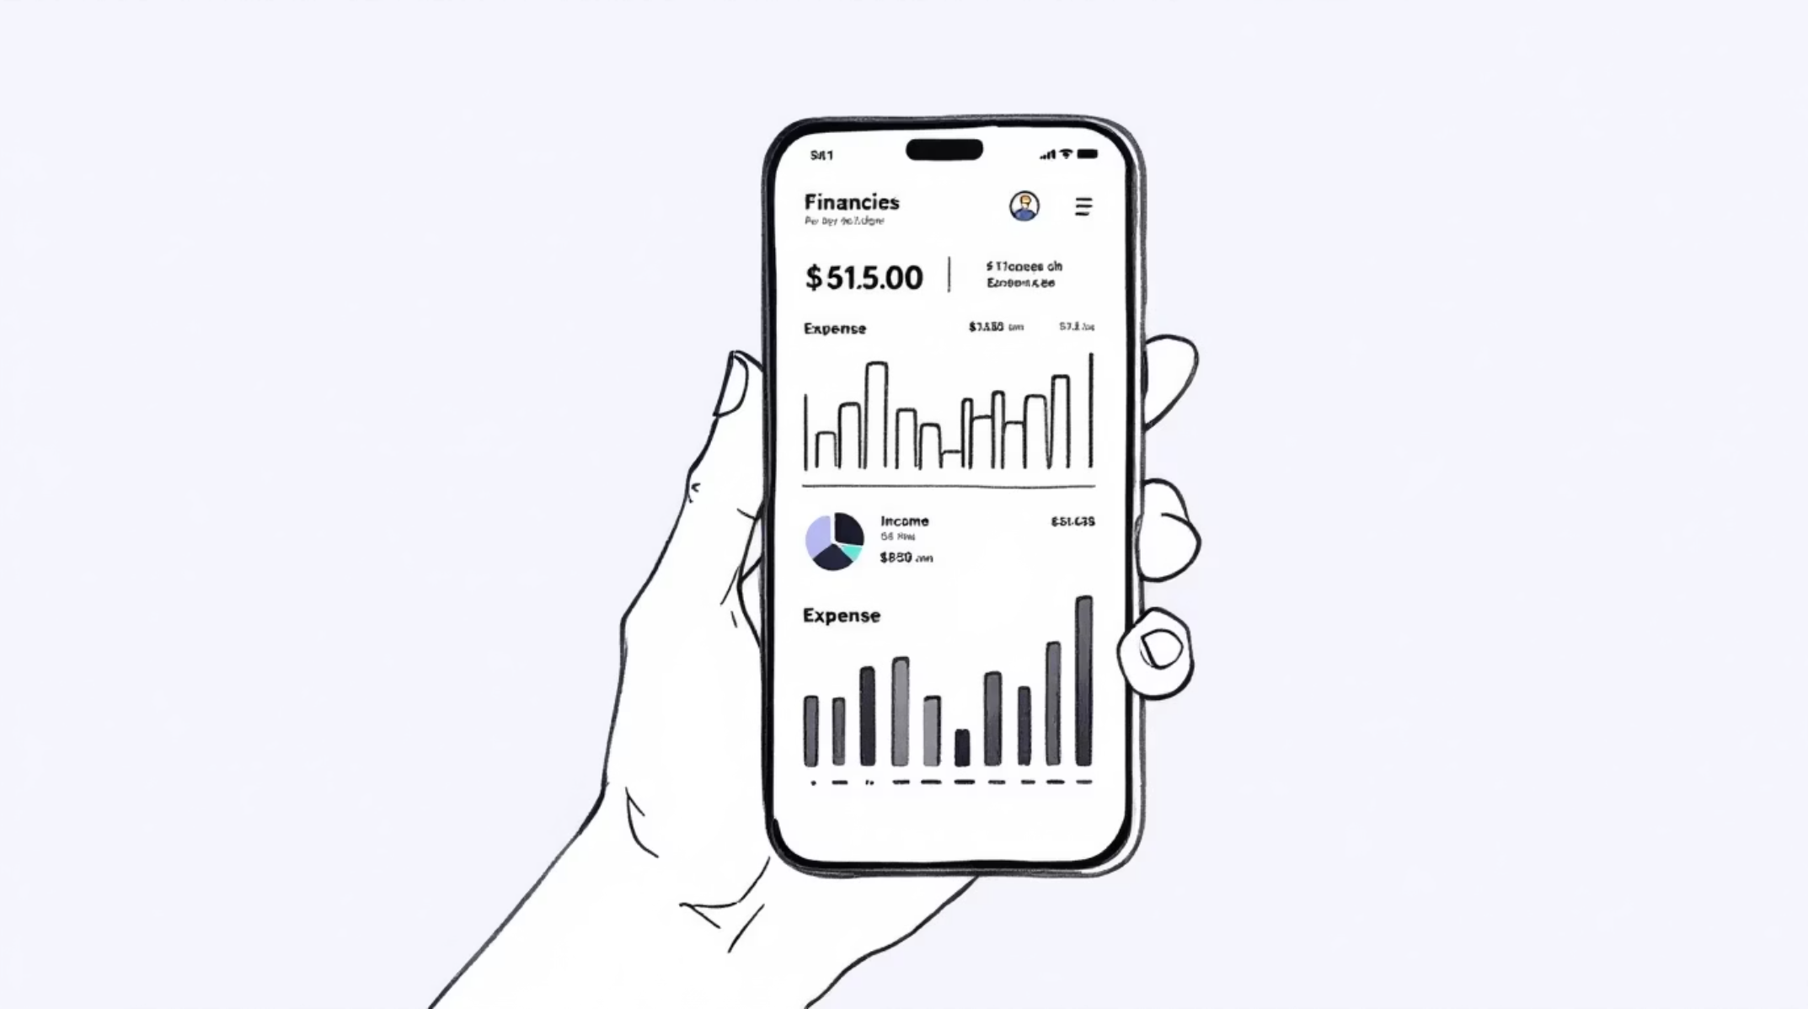
Project Overview
A mobile and web application designed to revolutionize personal finance management. This innovative tool empowers users to track income and expenses, visualize spending patterns, and set savings goals with unprecedented ease.
Our key differentiator is the integration of advanced AI-based prediction models that not only forecast future expenses but also analyze the underlying reasons for month-over-month spending increases, providing actionable improvement suggestions.

Slide 4

Automated Expense Entry
Simplify record-keeping with intelligent bill processing.
The system streamlines expense entry by allowing users to upload restaurant bills. Utilizing AI and Optical Character Recognition (OCR) technology, the application automatically extracts critical expense details such as total amount, date, and individual items.
Once extracted, AI intelligently categorizes the expense (e.g., Food & Dining), updating financial records instantly. This feature dramatically reduces the need for manual data entry, saving users time and ensuring accuracy.

Slide 5




CORE FOCUS
Key Objectives
Our primary goals are to empower users with financial intelligence.
Effortless Financial Management
Predictive Insights
Simplify daily income and expense tracking for all users.
Leverage machine learning to forecast future spending patterns.
Identify Spending Anomalies
Actionable Advice
Pinpoint the root causes of monthly expense increases.
Provide AI-driven suggestions for cultivating better financial habits.

Slide 6

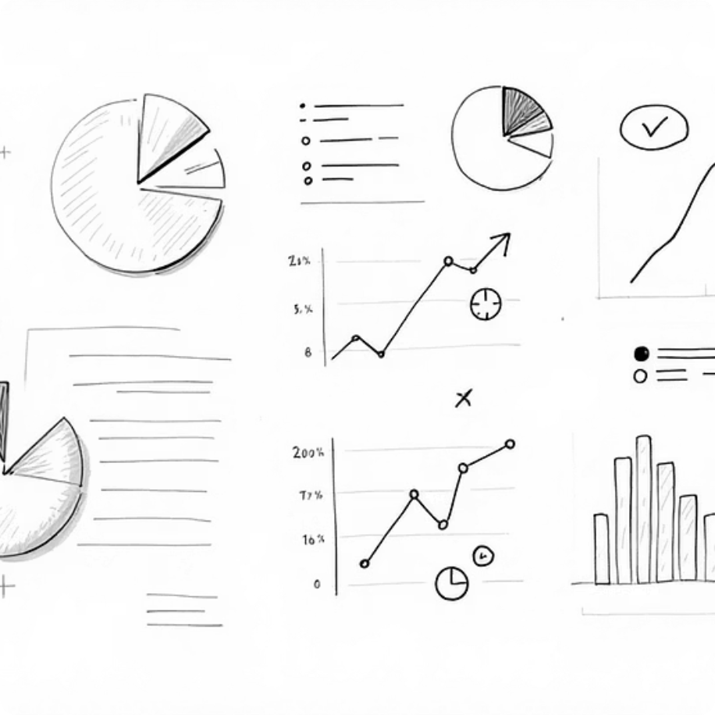
Core Functionality
Essential features for comprehensive financial control.
Income & Expense Tracking
Comprehensive Data Visualization
Seamlessly add, edit, and delete all financial transactions. Utilize intuitive categorization (Food, Rent, Travel, Shopping, etc.) for detailed record-keeping. Generate monthly and yearly reports for a clear overview of financial health.
Gain insights into spending habits with dynamic visual reports. Explore category-wise spending via interactive pie charts, compare monthly expenditures with clear bar graphs, and identify trends through insightful line charts.

Slide 7
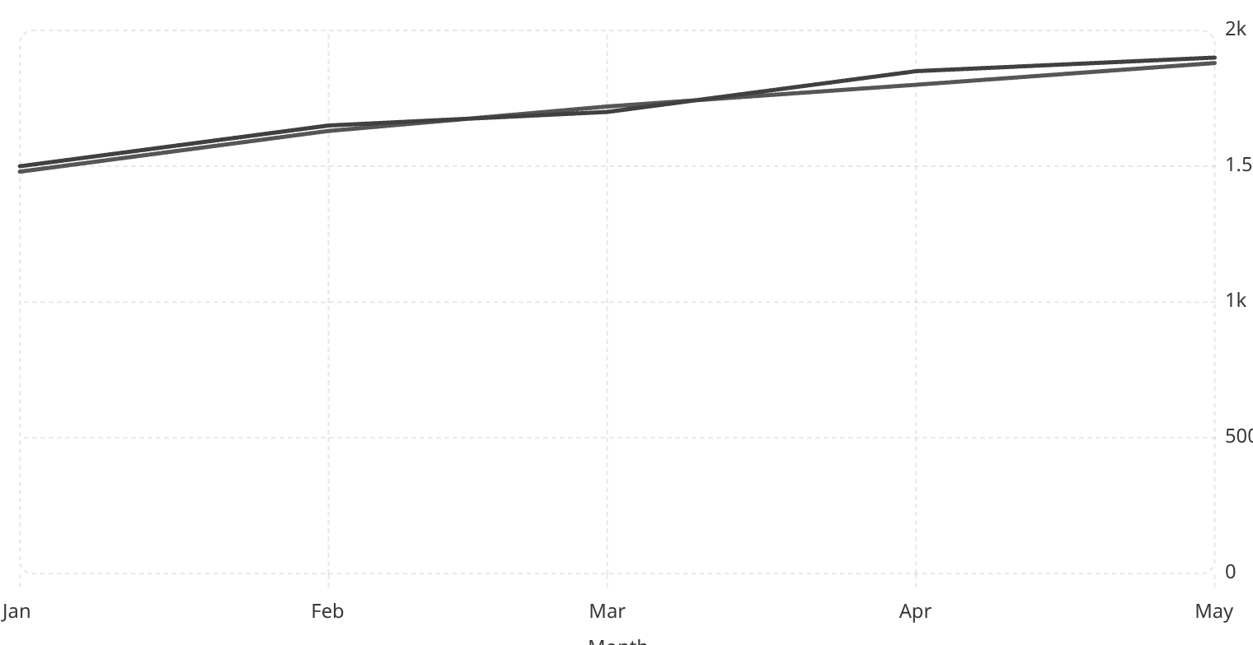
AI-Based Expense Prediction
Forecasting future spending to aid proactive financial planning.
Predicted Expense
Actual Expense
Our AI engine leverages historical financial data to accurately predict next month's expenses. This foresight enables users to anticipate upcoming financial needs and adjust their spending accordingly.
Machine Learning Models Utilized:
Linear Regression: For baseline predictions based on historical trends.
Time Series Forecasting: (ARIMA / LSTM) for more advanced, nuanced predictions, considering seasonal and cyclical patterns.
Example Insight: "Your expenses increased by 18% this month mainly due to higher restaurant spending and online shopping. Reducing dining out by 25% can help you save approximately ₹3,000 next month."

Slide 8
Expense Rise Detection: AI Insight Engine
Proactive alerts and personalized recommendations.
Category-wise Growth Analysis
Unusual Spending Patterns
Identifies specific spending categories experiencing significant increases.
Detects atypical transactions or sudden spikes in expenditure.
Recurring Subscriptions
Comparative Analysis
Monitors and flags active subscriptions to prevent overlooked costs.
Compares current spending against the previous three months for context.
The AI Insight Engine provides a concise summary of spending changes, coupled with actionable improvement suggestions and timely budget alerts to help users stay on track.

Slide 9





System Architecture
Built on the robust and flexible MERN Stack.
Frontend
AI/ML
Backend
Database
This modular architecture ensures scalability, high performance, and a seamless user experience across both web and mobile platforms.

Slide 10



Technology Stack Deep Dive
Frontend (React.js)
Backend (Node.js + Express.js)
Database (MongoDB)
Powers the intuitive User Dashboard, dynamic Charts & Analytics, the efficient Bill Upload Interface, and the clear AI Insight Display.
Stores critical data in collections: Users, Transactions, Categories, Predictions, and Uploaded Bills.
Manages REST APIs, secure Authentication (JWT), robust Expense Processing, and seamless AI Logic Integration.

